Slide 1
Algorithmic Trading Based on Trading Signals
Group 3
Mike Ryu
Nestor Aviles
Ty Ingebrigtsen
Will Hua

Slide 2
Part 1: Intro
Part 2: Tradings Based on Individual Technical Indicators
Part 3: Model Performance
Part 4: Current Findings and Future Plan

Slide 3
Assumptions:
Algorithmic Trading Based on Technical Analysis is practicable.
Algorithmic Trading Model will perform better on large cap stocks.
Algorithmic Trading Model will perform the worst on Cryptocurrencies and some meme stocks.
The more Trading Signals we use in our model, the more accurate or better performance our model will be/get.

Slide 4
Data Collection and Time Frame
Historical Stock and Cryptocurrency Data:
Yahoo Finance Library
Historical Stock and Cryptocurrency Technical Indicators Data:
Stockstats Library
Training Time Frame:
01/01/2016 - 12/31/2019
Testing Time Frame:
01/01/2020 - 04/30/2021

Slide 5
Machine Learning Libraries/Models
Scikit Learn - Random Forest Classifier
Scikit Learn - Naive Bayes GaussianNB Classifier
Other Models we tried but didn’t put in this presentation:
Gradient Boosting Classifier
CatBoost Classifier
CatBoost Regressor

Slide 6
Trading based on Individual Signals
$ETH-USA -- Ethereum, Market Cap: $446.33B, Cryptocurrency
$MRO -- Marathon Oil, Market Cap: $9.18B, Mid Cap
$EXPR -- Express, Inc., Market Cap: $198.11M, Small Cap
$TSLA -- Tesla, Inc., Market Cap: $605.97B, Large Cap

Slide 7
Technical Indicators and Trading Strategy
Relative Strength Index (RSI)
Buy when RSI < 30, Sell when RSI > 70.
Simple Moving Average(SMA)
Buy when SMA50 Cross SMA100 from below, Sell when Cross from above.
Bollinger Bands(BOLL)
Buy when Close < Bollinger Lower Band, Sell when Close > Bollinger Upper Band.

Slide 8
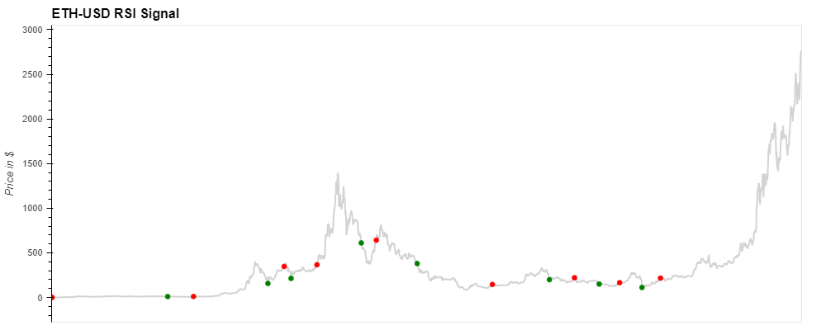
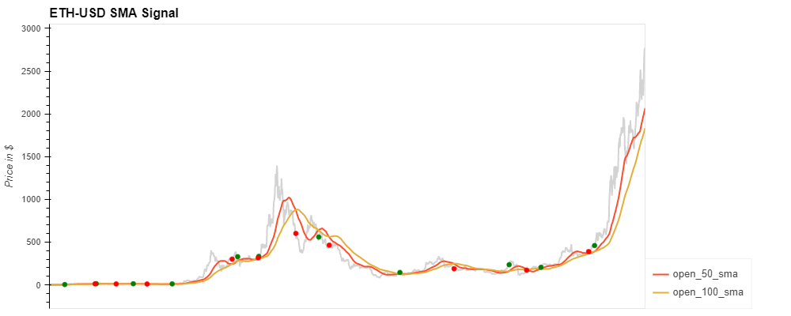
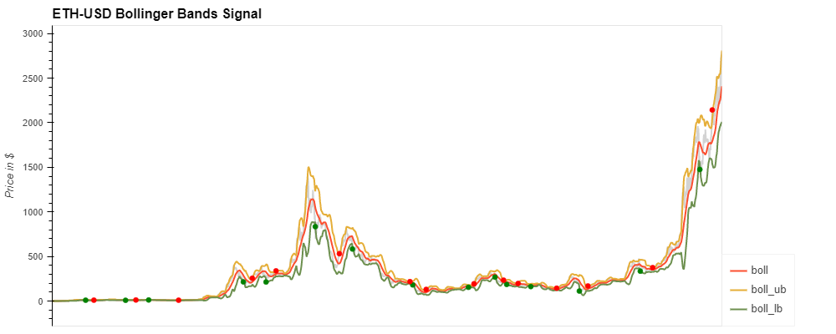

Slide 9
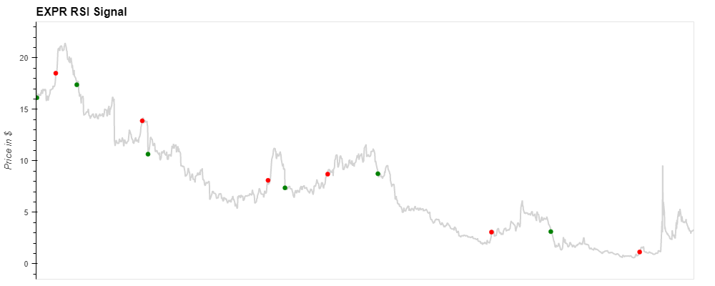
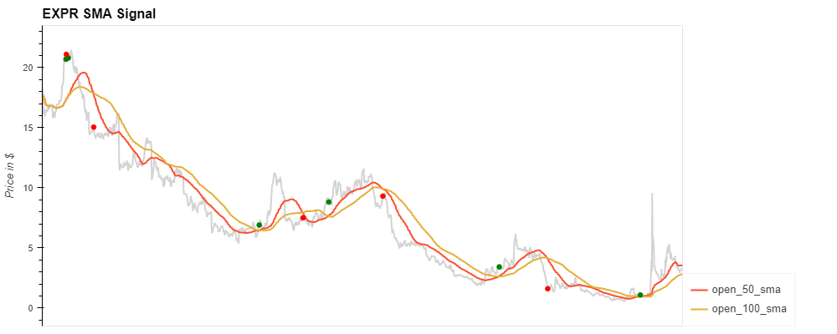
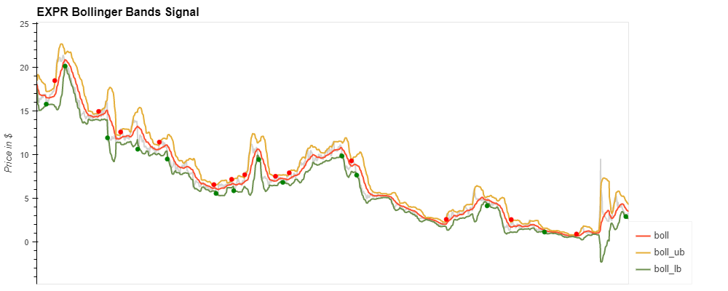

Slide 10
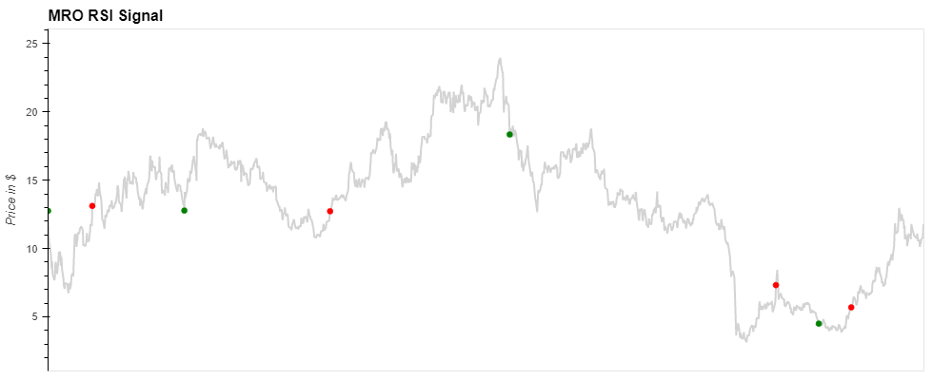
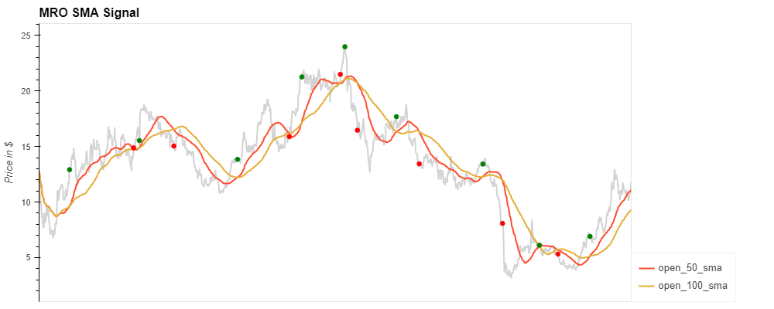
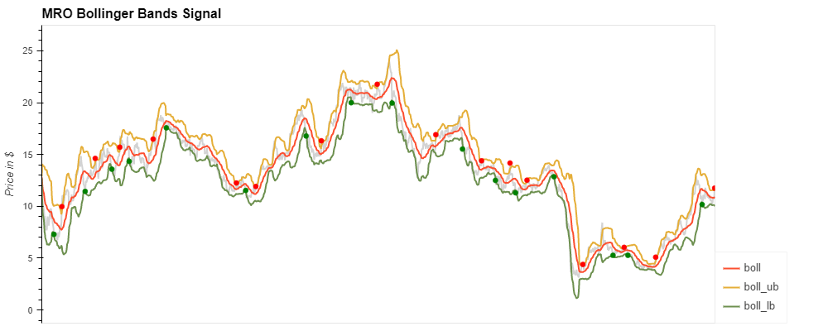

Slide 11
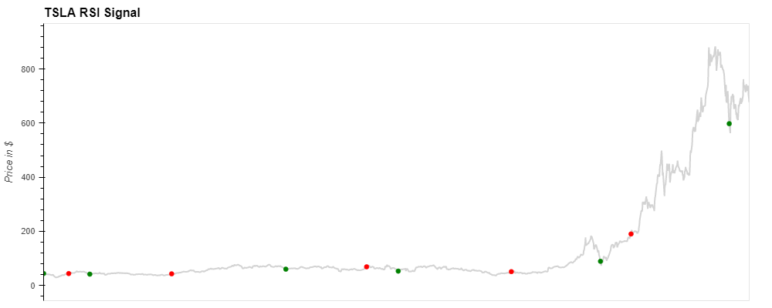
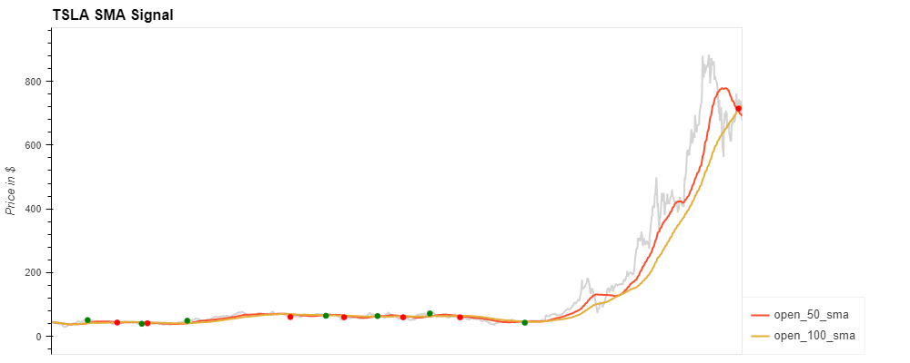
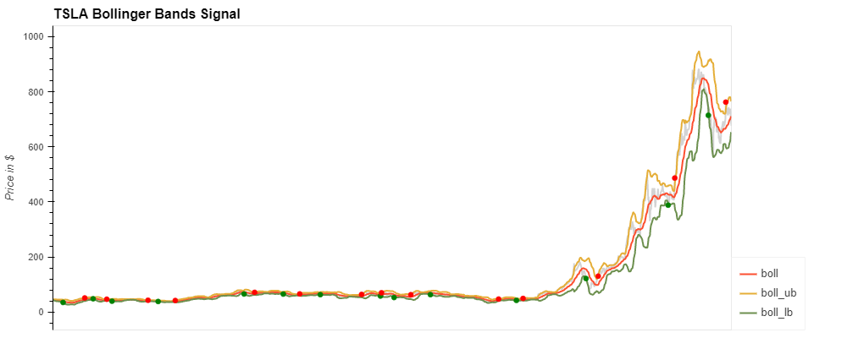

Slide 12
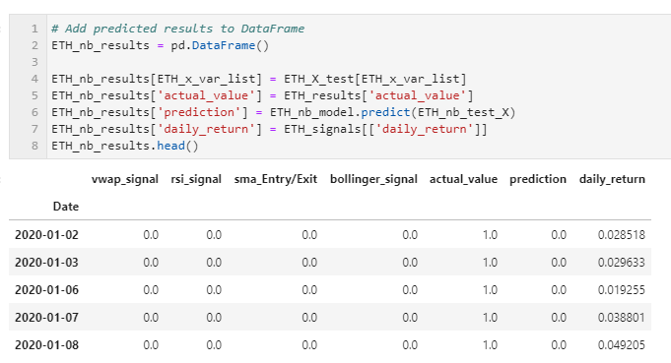
Training and Testing Data

Slide 13
Model Performance vs Market Performance
Market Performance
Random Forest Classifier Model Performance
Naive Bayes Classifier Model Performance

Slide 14
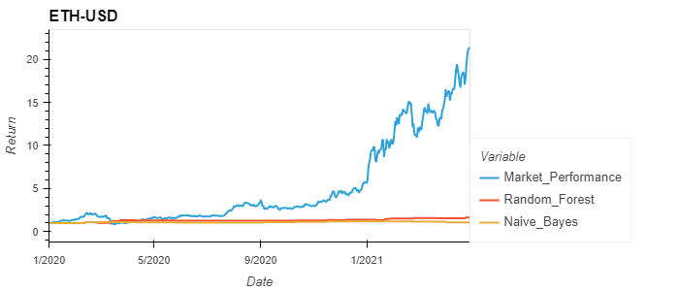

Slide 15
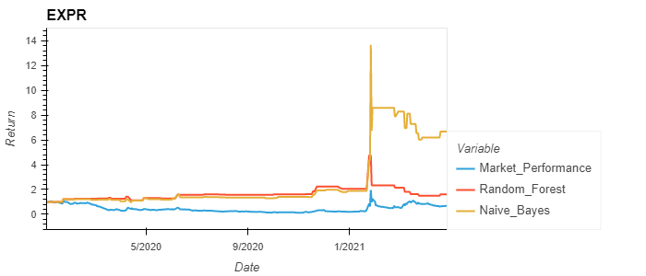

Slide 16
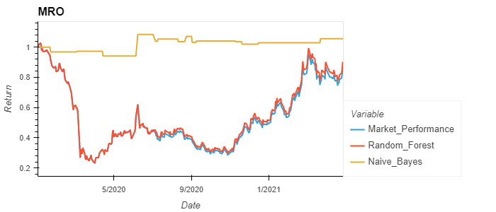

Slide 17
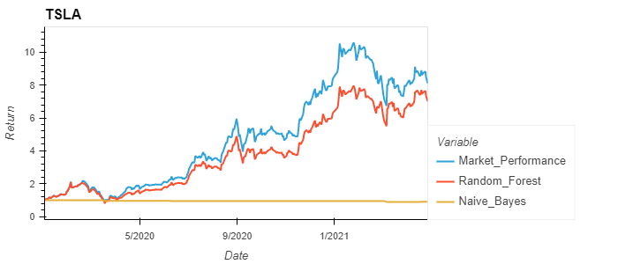

Slide 18
Current Findings
Accuracy Scores for both models are low, the reason could be because we used too few technical trading indicators and the trading indicators don’t trigger buy/sell signals very often. It caused our performance to be very similar to market performance or ‘HODL’. On the other hand, we added one more trading signal(VWAP - volume weighted average price, window =3) into our model after we produced the charts in this presentation. But we did not see a significant increase in our model accuracy or performance.
The larger cap the Ticker is, the more like market performance we will get.
Overall, Naive Bayes worked better in a flat or a downtrend market, for a uptrend market, we’d be better off if we just HODL.

Slide 19
Next Steps
Perfect our model by adding/removing/adjusting Technical Indicators, adjusting our triggers of the signals, balancing our training data and so forth.
Create a Ticker pool from different market sections (Industries, Market Caps, Index).
Add Fundamental Indicators to screen out overvalued(TBD) Tickers.
Build a trading bot to execute our trading strategy.
Hopefully it doesn’t yolo at the peak of some meme stocks or cryptocurrencies.

Slide 20
Questions?

